Slide 1

BMS College of Engineering
Department of Artificial Intelligence and Data Science
Deep Learning (23DS5PCDLG) | Mini Project on
Automated OMR Evaluation and Scoring System
Guided by Prof. Sangeetha
Elvis Bibu (1BM23AD021)
Kirthan A (1BM23AD030)
Sai Prashanth (1BM23AD051)

Slide 2
Sl. no. | Content
1 | Introduction
2 | Problem Statement
3 | Objectives
4 | Scope and Analysis
5 | Design and Implemenation
6 | Results & Interpretation
6 | Conclusion
Table of Contents

Slide 3
Introduction
The project, "Automated OMR Scoring System," revolutionizes the traditional grading process by bridging Computer Vision with Modern Deep Learning. It serves as a software-based pipeline that automates grading without the need for dedicated, expensive hardware scanners. The system leverages Convolutional Neural Networks (CNN) for mark recognition and traditional image processing for robust bubble detection.
Project Overview

Slide 4
Introduction
Time-Consuming: Manual evaluation of OMR sheets is labour-intensive and slow.
Human Error: Fatigue and subjectivity in manual checking lead to scoring inconsistencies.
Hardware Costs: Traditional OMR scanners are expensive and lack flexibility for diverse sheet formats.
Inflexibility: Current systems struggle with slight variations in sheet design or mark types (e.g., smudges).
Motivation

Slide 5
The existing manual grading process for OMR sheets is inherently inefficient and susceptible to human error.
Traditional scanning hardware remains costly and lacks the adaptability required for diverse applications.
This results in significant data processing bottlenecks, hindering efficient assessment management in educational and administrative contexts.
Problem Statement

Slide 6
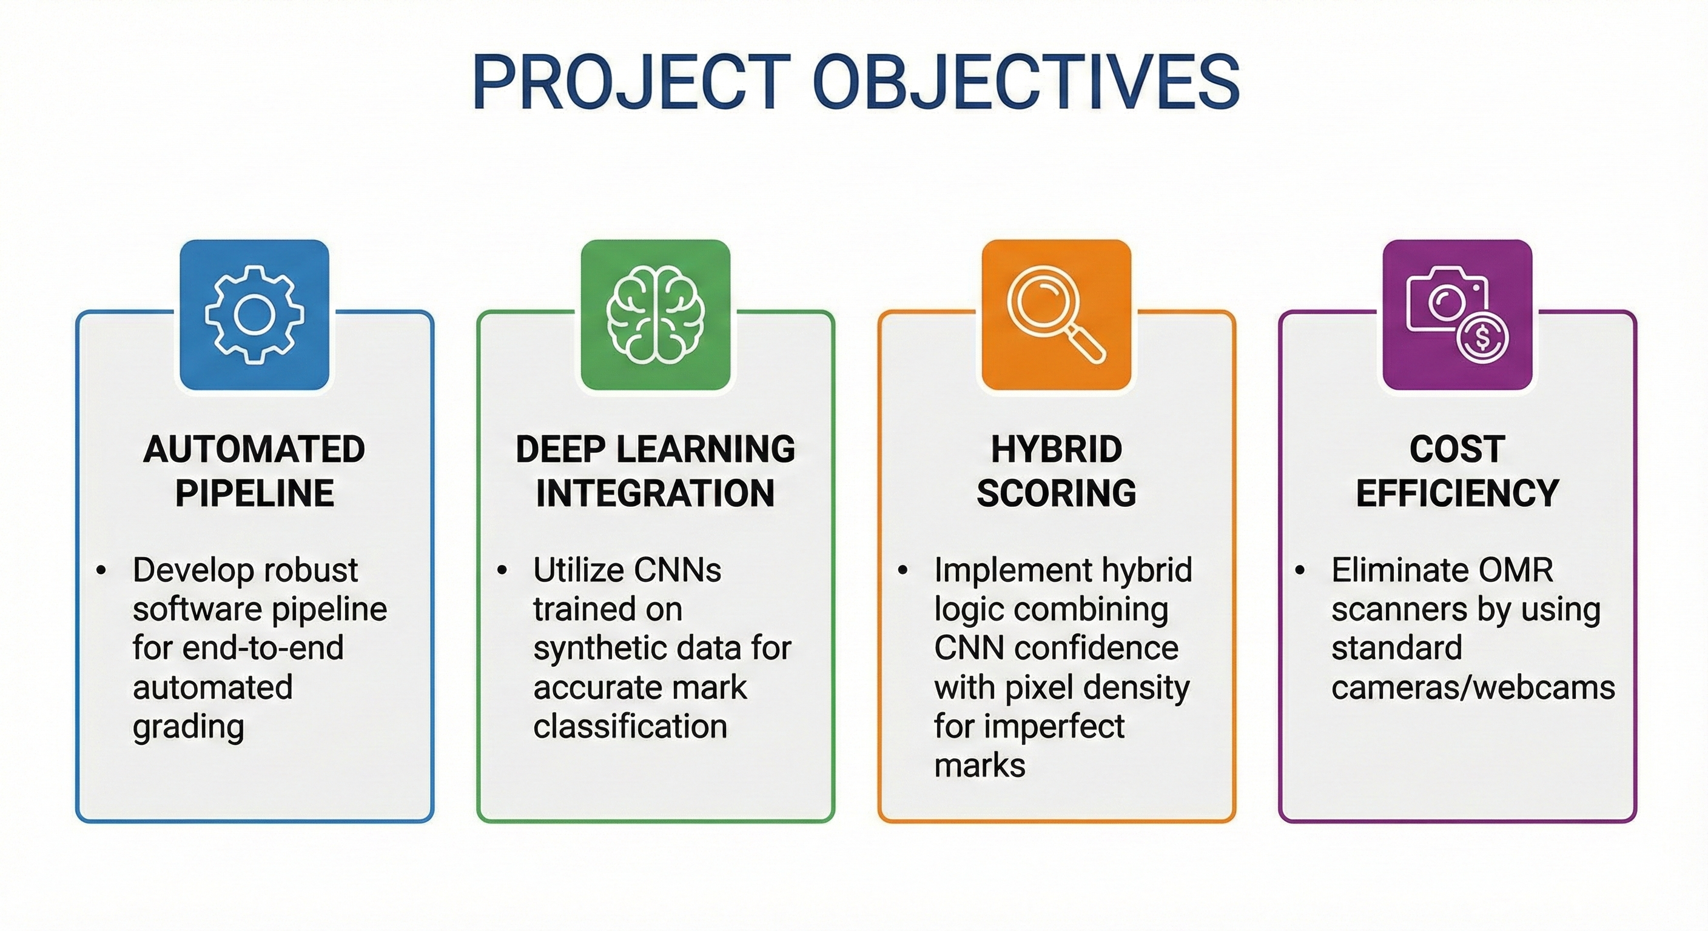
Objectives

Slide 7
Scope of the Project
Educational Institutions: Designed for schools and colleges to grade exams quickly using standard scanners or phone cameras.
Survey Analysis: Can be adapted to process survey forms and feedback sheets automatically.
Synthetic Data Generation: Includes a module to generate diverse synthetic training data to avoid bias.
End-to-End Automation: Covers the entire workflow from Image Input to CSV Report generation.
Scalability: The software-based nature allows it to be deployed on local machines or cloud servers without hardware dependencies.
Scope and Analysis
.

Slide 8
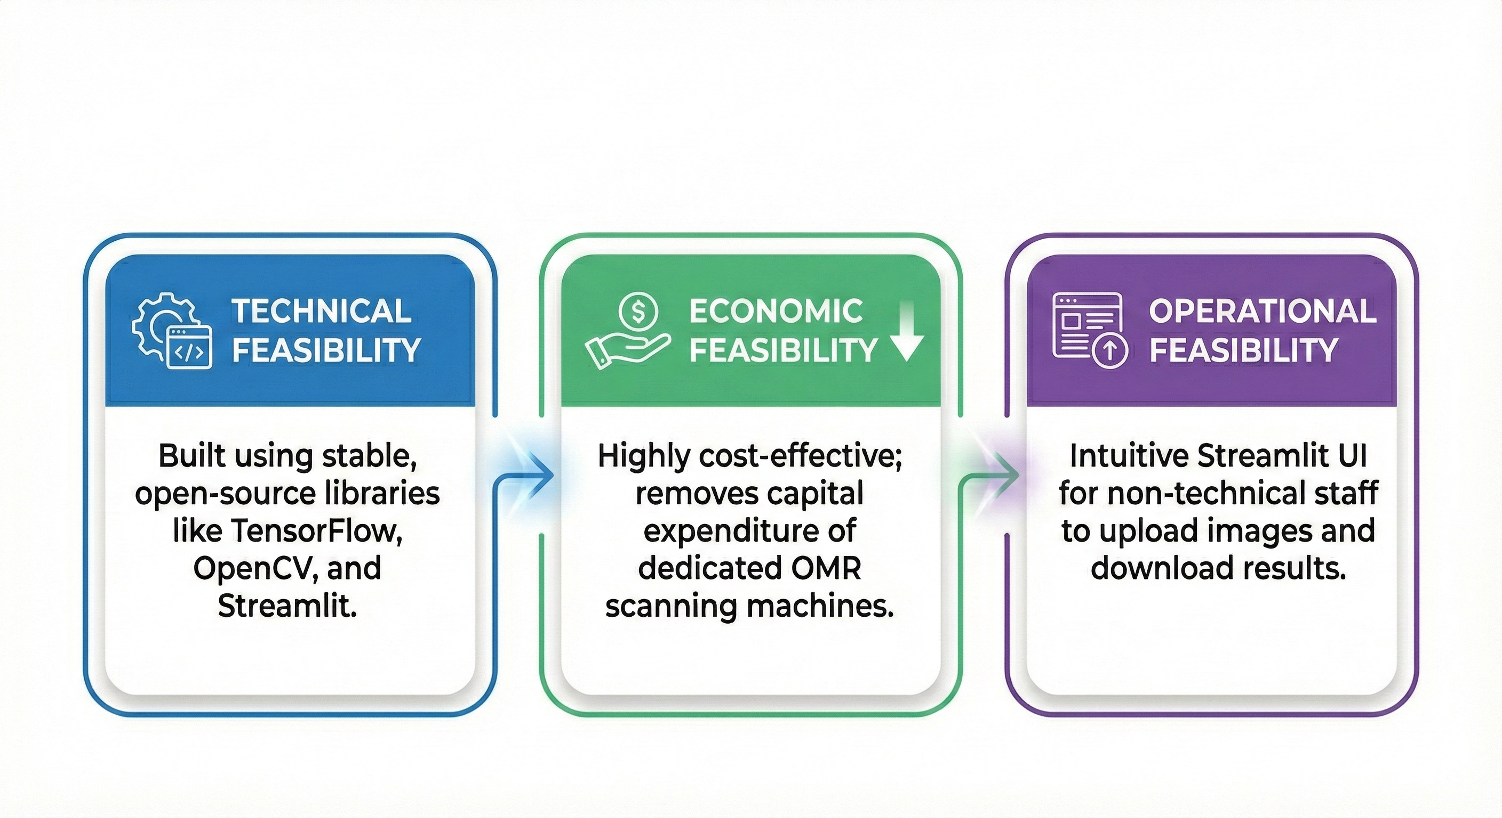
Feasibility Analysis
Scope and Analysis

Slide 9
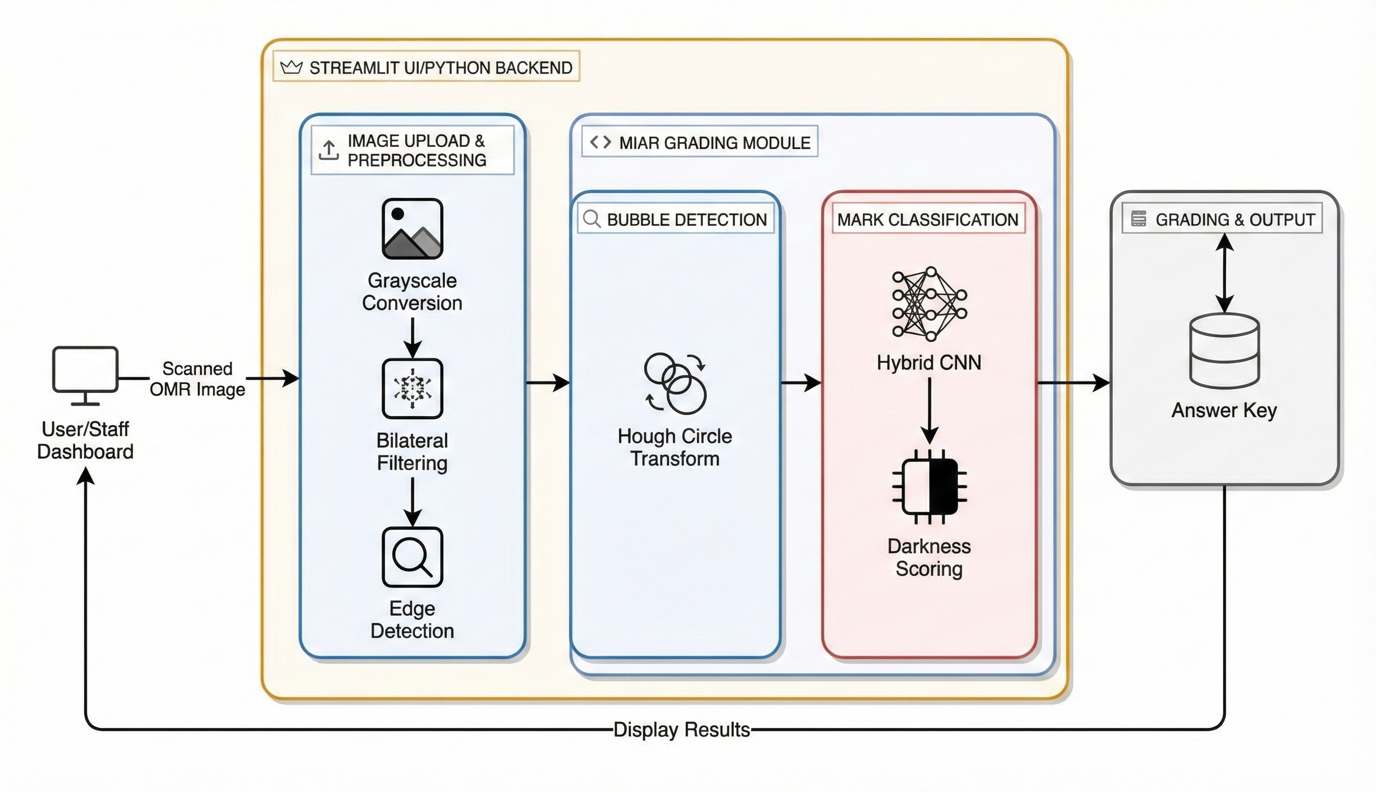
Architecture Diagram
Design &
Implementation

Slide 10
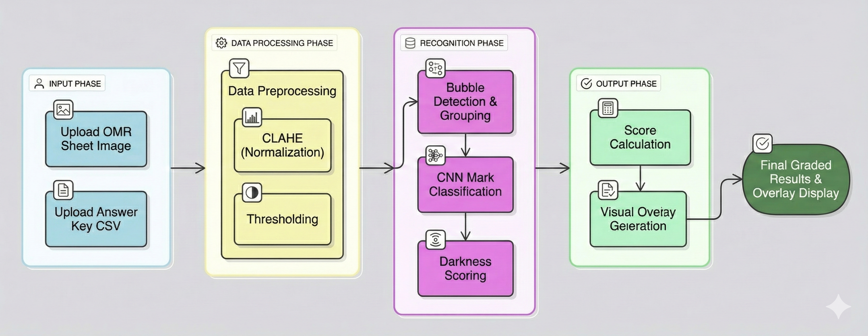
Workflow Diagram
Design &
Implementation

Slide 11
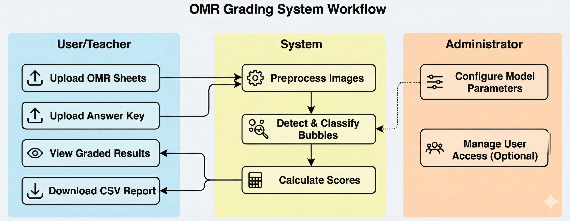
Use Case Diagram

Slide 12
Implementation: System Setup
Environment: The system is developed in Python 3.8+ using Visual Studio Code.
Core Libraries:
Computer Vision: OpenCV for image manipulation and bubble detection.
Deep Learning: TensorFlow/Keras for building and deploying the CNN model.
Data Handling: NumPy and Pandas for matrix operations and report generation.
Interface: Streamlit is used to create a responsive web-based user interface.
Hardware: Optimized to run on standard CPUs (Intel i5/i7) with optional GPU acceleration.
Design &
Implementation

Slide 13
Implementation: AI Assistant & RAG Integration
Preprocessing Pipeline: Applies Grayscale conversion, Bilateral Filter for noise reduction, and CLAHE for contrast enhancement.
Bubble Detection: Utilizes Hough Circle Detection to find potential bubbles, followed by coordinate sorting to group them into questions.
Hybrid Scoring Logic:
Primary: CNN model classifies the bubble image (Marked vs. Unmarked).
Secondary: Pixel density (darkness scoring) validates the CNN prediction.
4. Synthetic Data: A custom module generates synthetic OMR samples to train the model, ensuring it generalizes well to unseen data.
Design &
Implementation

Slide 14
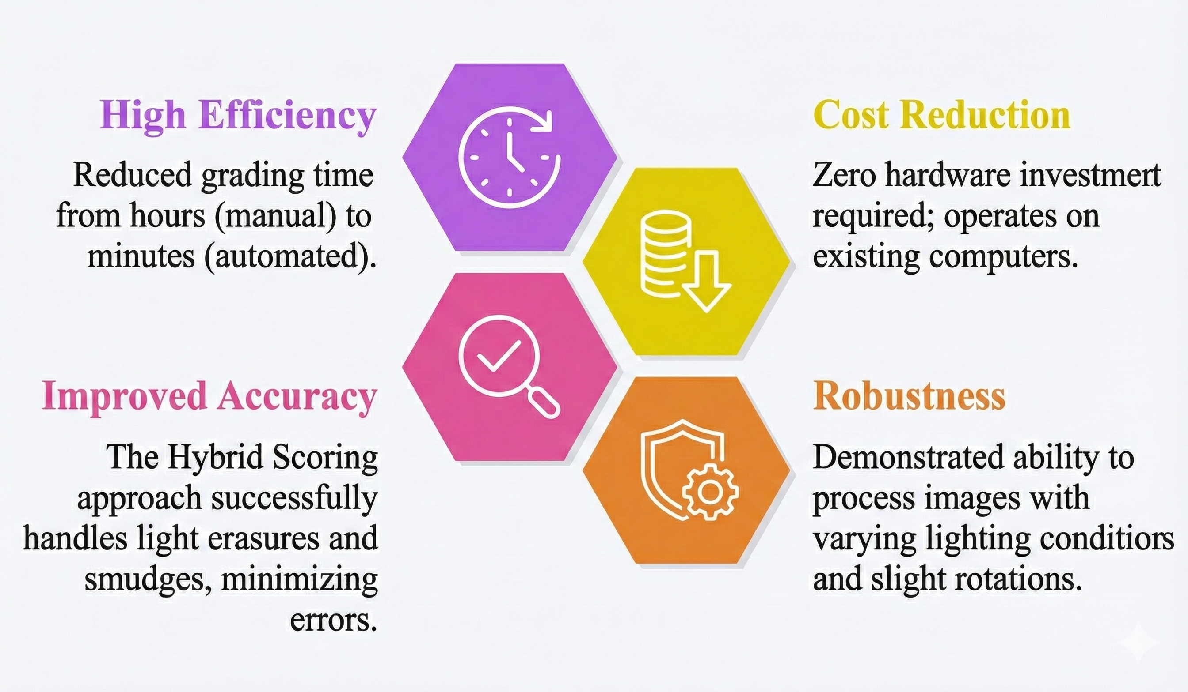
Key Results
Results &
Interpretation

Slide 15
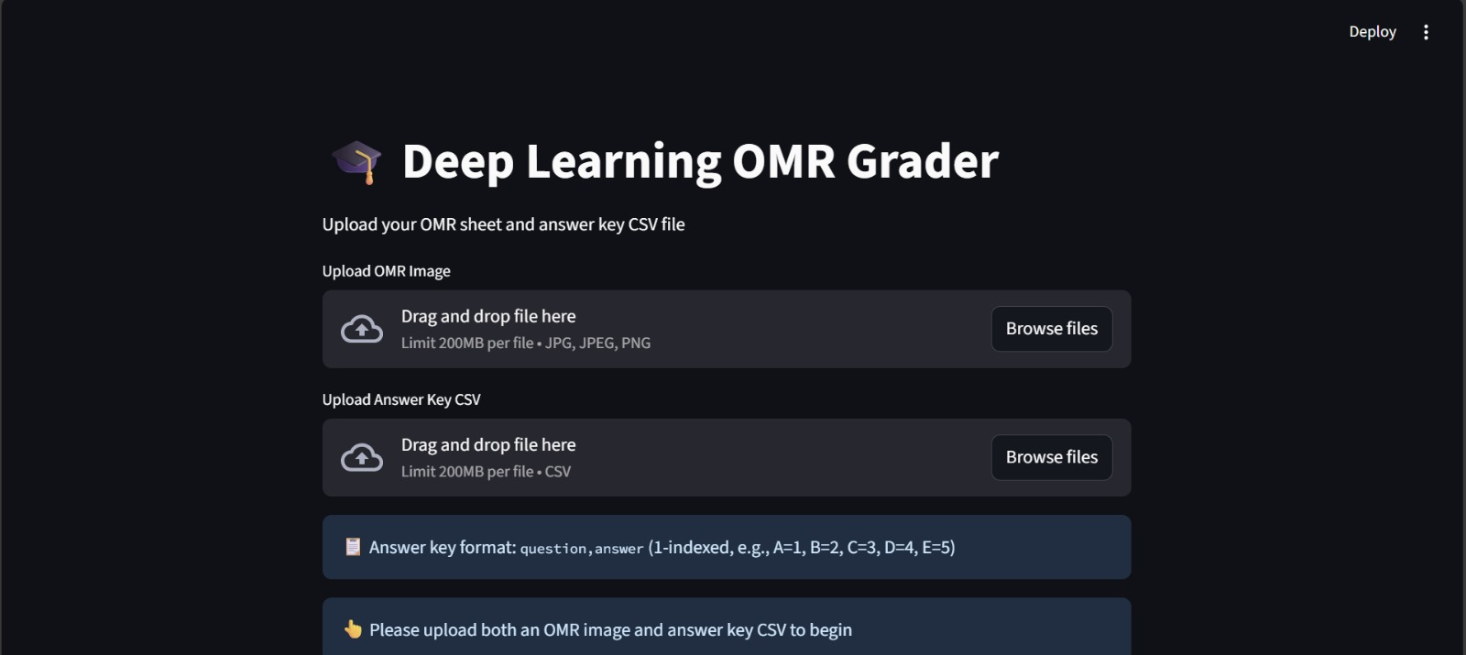
Snapshots of Dashboard
Results &
Interpretation

Slide 16
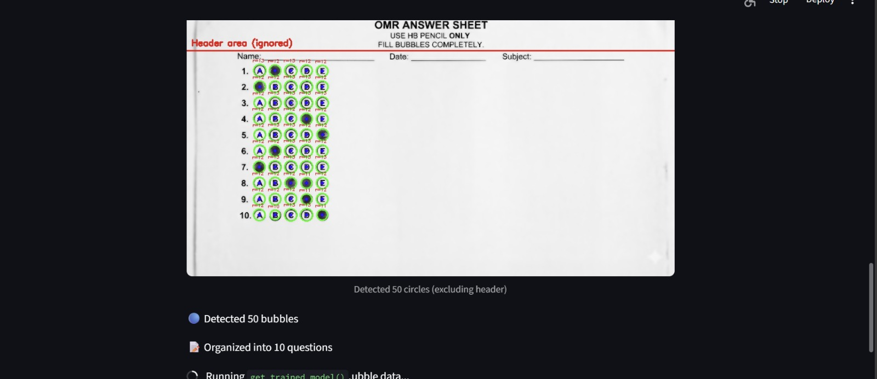
Snapshots of Dashboard
Results &
Interpretation

Slide 17
Interpretation
Feasibility Confirmed: The project proves that software pipelines can effectively replace legacy hardware.
Synthetic Data Success: Self-Supervised Learning using synthetic data allowed the model to generalize without a massive human-labeled dataset.
Hybrid Robustness: Combining Deep Learning with pixel density analysis significantly improved reliability compared to rule-based systems, especially for edge cases like erasures.
Operational Efficiency: The end-to-end workflow meets the objective of minimizing human error and processing time.
Results &
Interpretation

Slide 18
The Automated OMR Scoring System successfully demonstrates a cost-effective, software-based alternative to traditional grading.
By integrating CNNs with Computer Vision, the system achieves high accuracy and robustness against image variations.
The use of synthetic data solves the challenge of data scarcity and manual labeling.
The solution provides educational institutions with a flexible, fast, and accurate tool for assessment, democratizing access to automated grading technology.
Conclusion

Slide 19
[1, 2025].
[1] Y. LeCun, L. Bottou, Y. Bengio, and P. Haffner, "Gradient-based learning applied to document recognition," Proceedings of the IEEE, vol. 86, no. 11, pp. 2278–2324, Nov. 1998.
[2] A. Deng, "Deep Learning for OMR," arXiv preprint, 2020.
[3] OpenCV, "Hough Circle Transform," OpenCV Documentation. [Online]. Available: https://docs.opencv.org/. [Accessed: Dec. 08, 2025].
[4] Streamlit, "Building Data Apps," Streamlit Documentation. [Online]. Available: https://streamlit.io/. [Accessed: Dec. 08, 2025].
[5] TensorFlow, "Image Classification with CNNs," TensorFlow Core. [Online]. Available: https://www.tensorflow.org/. [Accessed: Dec. 08, 2025].
References

Slide 20

Thank You
Dept. of AI&DS, B.M.S.C.E

